Slide 1



EnviroSense - Smart Temperature and Humidity Monitoring System

Slide 2
Introduction:
EnviroSense is your go-to solution for real-time temperature and humidity monitoring. Designed for simplicity and efficiency, it offers continuous tracking, instant alerts, and optional remote access. With a user-friendly interface, energy efficiency, and a robust enclosure, EnviroSense ensures a smarter, more comfortable indoor environment. Welcome to enhanced living with EnviroSense.

Slide 3
Problem Statement
1-Real-time Monitoring
2-User-Friendly Output
3-Alert Mechanism
4-Remote Access
5-Problem Detection and Notification
6-Energy Efficiency

Slide 4
Materials/Tools:

Slide 5
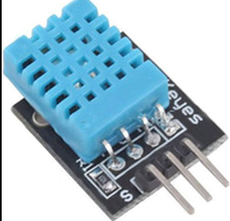
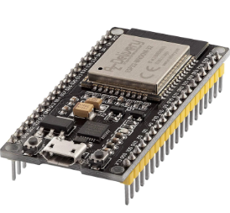
ESP32:
DHT Sensor:

Slide 6
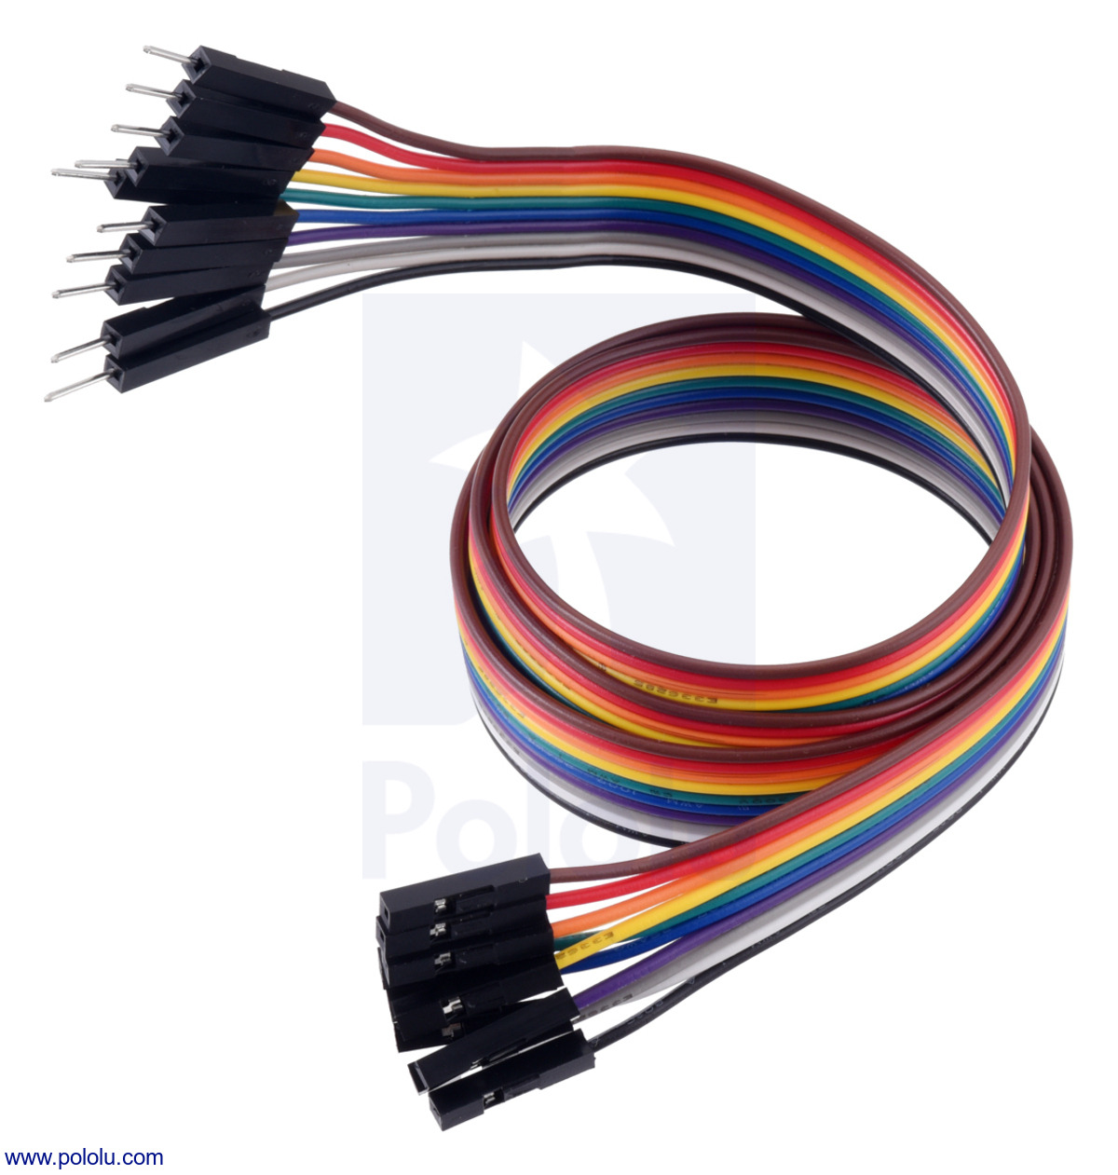
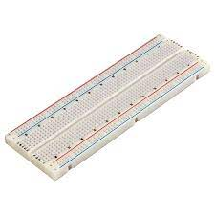
Jumper wires:
Bread

Slide 7
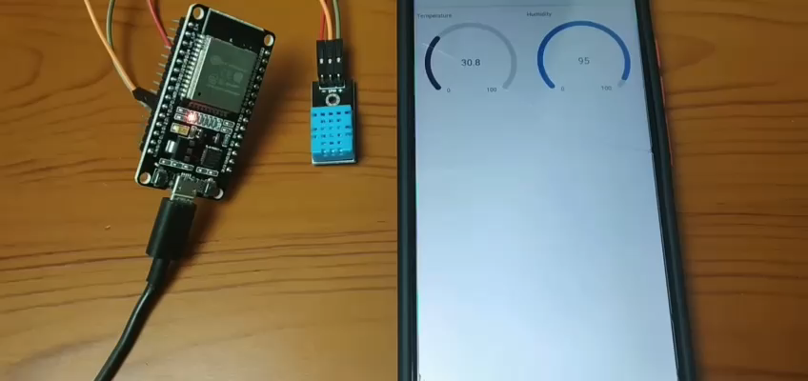

Slide 8
Thanks
Supervised By Dr:
Laith W. AL Shehab.
Prepared by:
Shamsaldin mohanad abdin 201810454.
Mohammad Abu Gharbieh 201910372.

